Slide 1
Database Design and Modeling
Prepared by Chala Urgessa

Slide 2
Content
Data models
ER model - Database Modeling
Business rule

Slide 3
Data Modeling and Data Models
Data Model
A relatively simple representation, usually graphical, of more complex real-world data structures.
Within the database environment, representing data structures and their characteristics, relations, constrains, transformations, and other constructs.
A “blueprint” containing all the instructions to build a database that meet all end-user requirements.

Slide 4
An implementation-ready data model should contain at least the following components:
A description of the data structure that will store the end-user data.
A set of enforceable rules to guarantee the integrity of the data.
A data manipulation methodology to support the real-world data transformations.

Slide 5
Design Phases
Initial phase - characterize fully the data needs of the prospective database users.
Second phase - choosing a data model
Applying the concepts of the chosen data model
Translating these requirements into a conceptual schema of the database.
A fully developed conceptual schema indicates the functional requirements of the enterprise.
Describe the kinds of operations (or transactions) that will be performed on the data.

Slide 6
Design Phases (Cont.)
Final Phase - Moving from an abstract data model to the implementation of the database
Logical Design – Deciding on the database schema.
Database design requires that we find a “good” collection of relation schemas.
Business decision – What attributes should we record in the database?
Computer Science decision – What relation schemas should we have and how should the attributes be distributed among the various relation schemas?
Physical Design – Deciding on the physical layout of the database

Slide 7
Design Alternatives
In designing a database schema, we must ensure that we avoid two major pitfalls:
Redundancy: a bad design may result in repeat information.
Redundant representation of information may lead to data inconsistency among the various copies of information
Incompleteness: a bad design may make certain aspects of the enterprise difficult or impossible to model.
Avoiding bad designs is not enough. There may be a large number of good designs from which we must choose.

Slide 8
Design Approaches
Entity Relationship Model (covered in this chapter)
Models an enterprise as a collection of entities and relationships
Entity: a “thing” or “object” in the enterprise that is distinguishable from other objects
Described by a set of attributes
Relationship: an association among several entities
Represented diagrammatically by an entity-relationship diagram:
Normalization Theory (Chapter 6)
Formalize what designs are bad, and test for them

Slide 9
ER model - Database Modeling

Slide 10
ER model - Database Modeling
The ER data model was developed to facilitate database design by allowing specification of an enterprise schema that represents the overall logical structure of a database.
The ER model also has an associated diagrammatic representation, the ER diagram, which can express the overall logical structure of a database graphically.

Slide 11
Data Model Components
Entity
Attribute
Relationship
Constraint

Slide 12
Entity
Anything about which data are to be collected and stored
a person
a place
an event
Each entity occurrence is unique and distinct
STUDENT is an entity
Billy is an entity occurrence
Entities can be physical objects and abstractions
Entity names are often capitalized as a convention

Slide 13
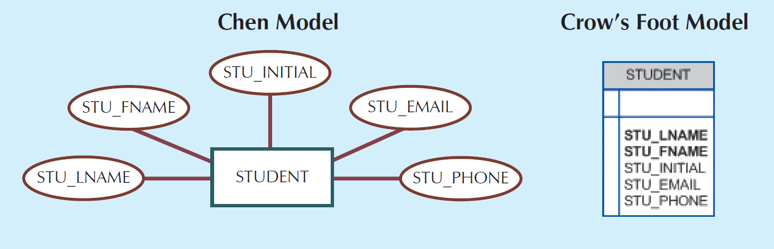
Entity (Cont...)
An entity is represented by a rectangle containing the entity’s name – a noun, in all capital letters.

Slide 14
Attribute
An entity is represented by a set of attributes; i.e., descriptive properties possessed by all members of an entity set.
Example:
instructor = (ID, name, salary ) course= (course_id, title, credits)
What are the attributes of the STUDENT entity?
More Examples:
★ Entities (objects)
✔ E.g. customers, accounts, bank branch
★ Relationships between entities
✔ E.g. Account A-101 is held by customer Johnson
✔ Relationship set depositor associates customers with accounts

Slide 15
Entity Sets - instructor and student
A subset of the attributes form a primary key of the entity set; i.e., uniquely identifying each member of the set.

Slide 16
Representing Entity sets in ER Diagram
Entity sets can be represented graphically as follows:
Rectangles represent entity sets.
Attributes listed inside entity rectangle
Underline indicates primary key attributes

Slide 17
Attributes
Attributes are characteristics of entities.

Slide 18
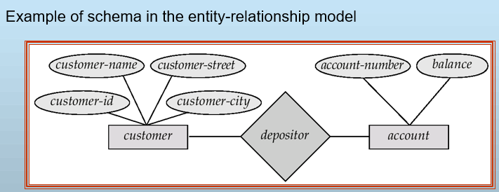
Entity-Relationship Model
Widely used for database design
★ Database design in E-R model usually converted to design in the relational model (coming up next) which is used for storage and processing

Slide 19
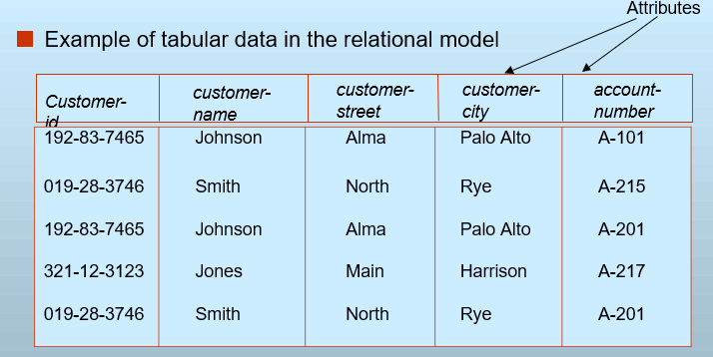
Relational Model

Slide 20
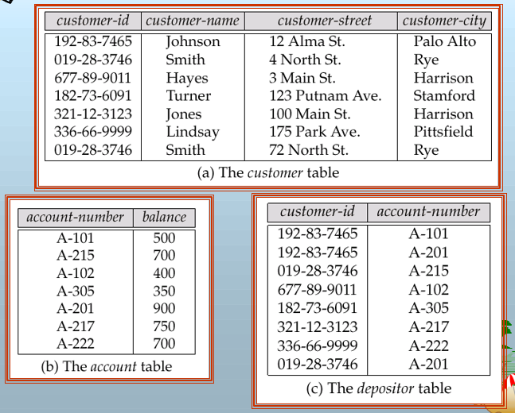
A Sample Relational Database

Slide 21
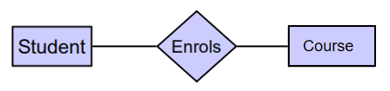
A Sample Relational Database
Sid | Name | GPA
20201 | Amy | 3.1
20202 | Tom | 3.5
20203 | Ben | 3.5
20204 | Tom | 3.2
Sid | CoureID | Grade
20201 | 101 | A
20201 | 102 | A
20202 | 101 | B
20203 | 103 | B
20204 | 101 | A
CourseID | Coursename | Credits
101 | COMP1 | 6
102 | COMP2 | 6
103 | COMP3 | 6
203 | COMP3 | 12

Slide 22
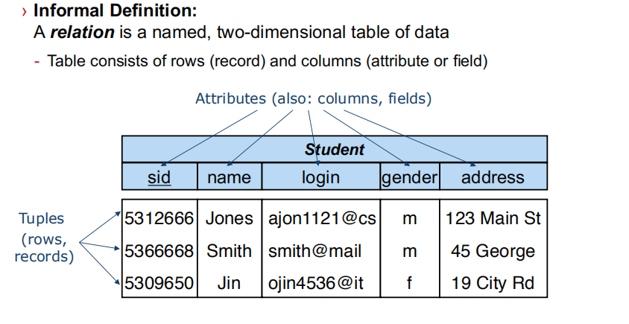
Relation – table
Tuple – each row
Attribute – each column

Slide 24
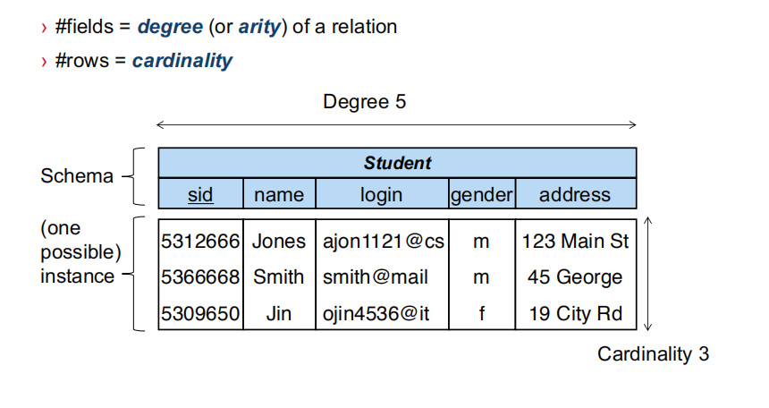

Slide 25
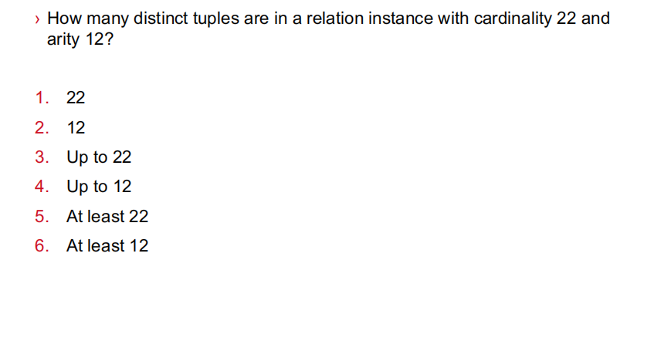

Slide 26
Relationship Sets (Cont.)
Example: we define the relationship set advisor to denote the associations between students and the instructors who act as their advisors.
Pictorially, we draw a line between related entities.

Slide 27
Representing Relationship Sets via ER Diagrams
Diamonds represent relationship sets.

Slide 28
Relationship Sets (Cont.)
An attribute can also be associated with a relationship set.
For instance, the advisor relationship set between entity sets instructor and student may have the attribute date which tracks when the student started being associated with the advisor

Slide 29
Relationship Sets with Attributes

Slide 30
Roles
Entity sets of a relationship need not be distinct
Each occurrence of an entity set plays a “role” in the relationship
The labels “course_id” and “prereq_id” are called roles.

Slide 31
Degree of a Relationship Set
Binary relationship
involve two entity sets (or degree two).
most relationship sets in a database system are binary.
Relationships between more than two entity sets are rare. Most relationships are binary. (More on this later.)
Example: students work on research projects under the guidance of an instructor.
relationship proj_guide is a ternary relationship between instructor, student, and project

Slide 32
Non-binary Relationship Sets
Most relationship sets are binary
There are occasions when it is more convenient to represent relationships as non-binary.
E-R Diagram with a Ternary Relationship

Slide 33
Complex Attributes
Attribute types:
Simple and composite attributes.
Single-valued and multivalued attributes
Example: multivalued attribute: phone_numbers
Derived attributes
Can be computed from other attributes
Example: age, given date_of_birth
Domain – the set of permitted values for each attribute

Slide 34
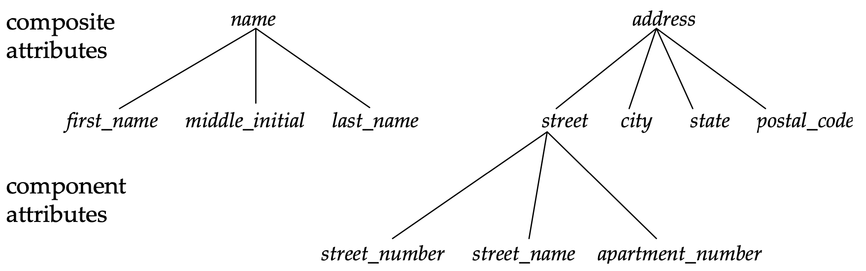
Composite Attributes
Composite attributes allow us to divided attributes into subparts (other attributes).

Slide 35
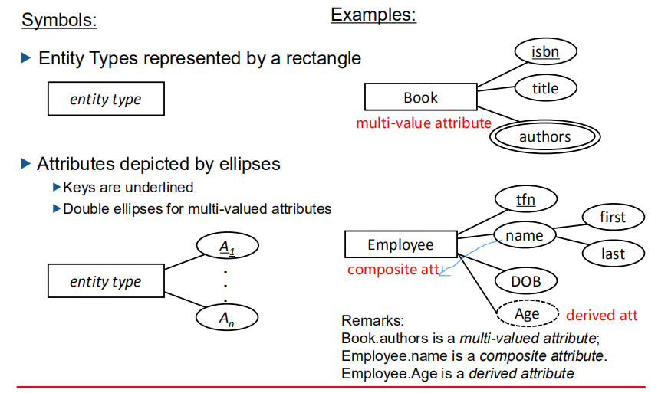

Slide 36
Representing Complex Attributes in ER Diagram

Slide 37
Business Rules
A brief, precise and unambiguous description of a policy, procedure, or principle within a specific organization.
Derived from a detailed description of an organization's operations.
Used to define entities, attributes, relationships and constraints.

Slide 38
Translating Business Rules into Data Model Components
a noun -> an entity
a verb associating nouns -> a relationship
to properly identify the relationship type, asking two questions
How many instances of B are related to one instance of A?
How many instances of A are related to one instance of B?

Slide 39
Mapping Cardinality Constraints
Express the number of entities to which another entity can be associated via a relationship set.
Most useful in describing binary relationship sets.
For a binary relationship set the mapping cardinality must be one of the following types:
one-to-one, 1:1, 1..1
one-to-many, 1:M, 1..M
One customer generate many invoices
Each of the many invoices is generated by only one customer
CUSTOMER generates INVOICE
many-to-many, M:M, M..M
Relations are bidirectional.

Slide 40
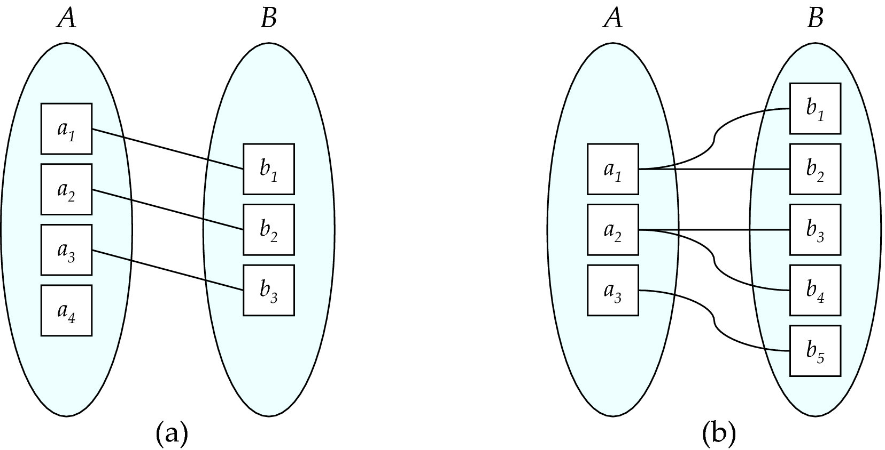
Mapping Cardinalities
One to one
One to many
Note: Some elements in A and B may not be mapped to any elements in the other set

Slide 41
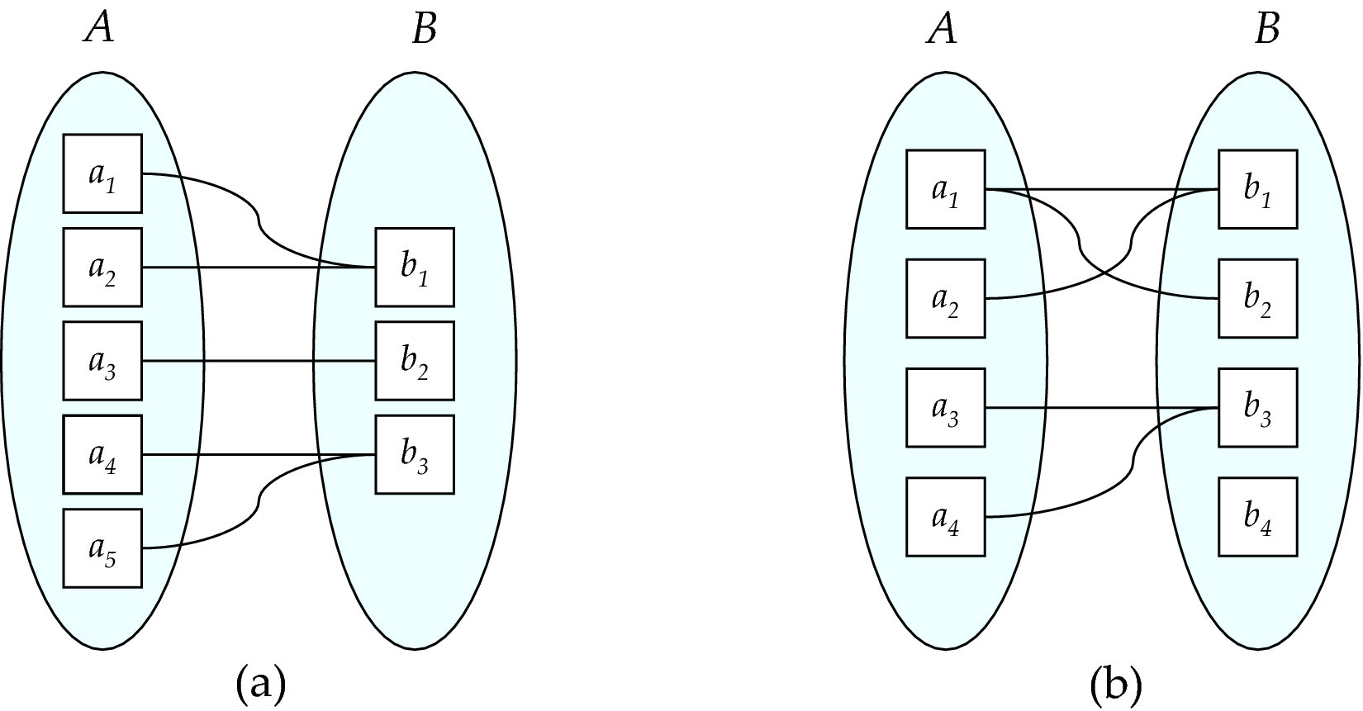
Mapping Cardinalities
Many to one
Many to many
Note: Some elements in A and B may not be mapped to any elements in the other set

Slide 42
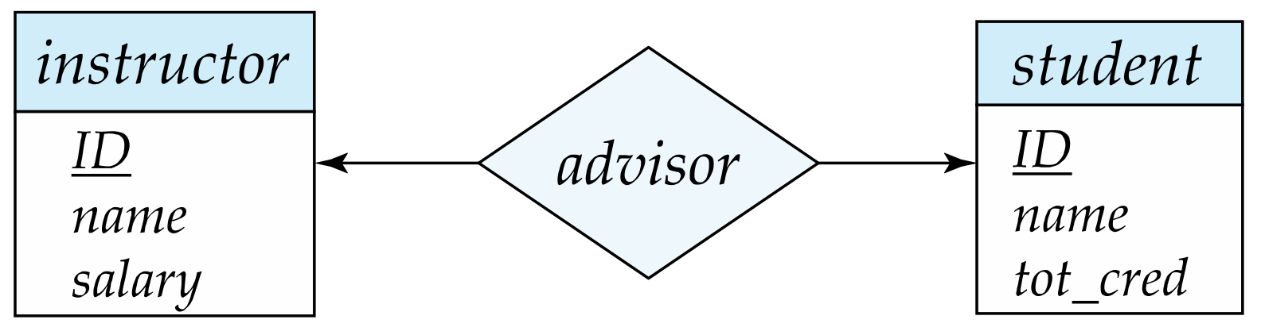
Representing Cardinality Constraints in ER Diagram
We express cardinality constraints by drawing either a directed line (→), signifying “one,” or an undirected line (—), signifying “many,” between the relationship set and the entity set.
One-to-one relationship between an instructor and a student :
A student is associated with at most one instructor via the relationship advisor
A student is associated with at most one department via stud_dept

Slide 43
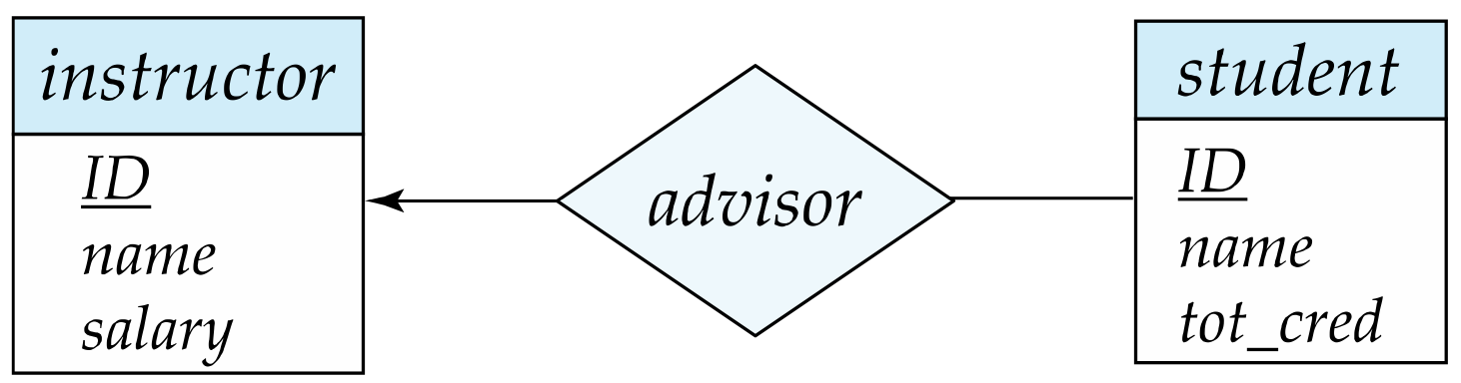
One-to-Many Relationship
one-to-many relationship between an instructor and a student
an instructor is associated with several (including 0) students via advisor
a student is associated with at most one instructor via advisor,

Slide 44
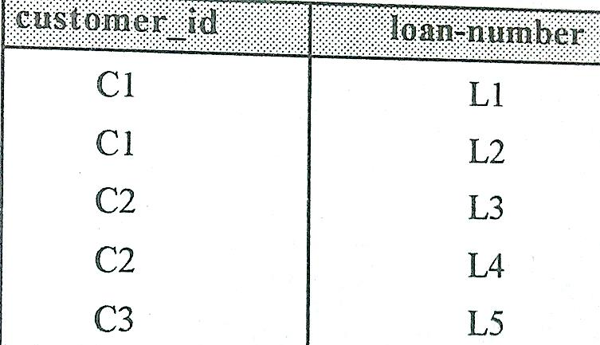
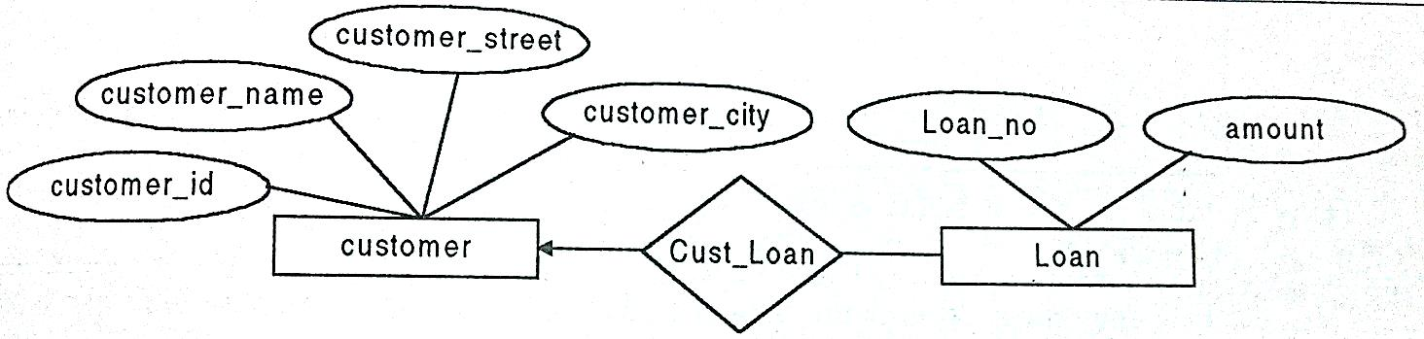
Customer and Loan relationship with 1:M type

Slide 45
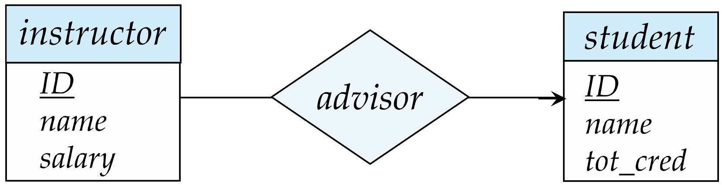
Many-to-One Relationships
In a many-to-one relationship between an instructor and a student,
an instructor is associated with at most one student via advisor,
and a student is associated with several (including 0) instructors via advisor

Slide 46
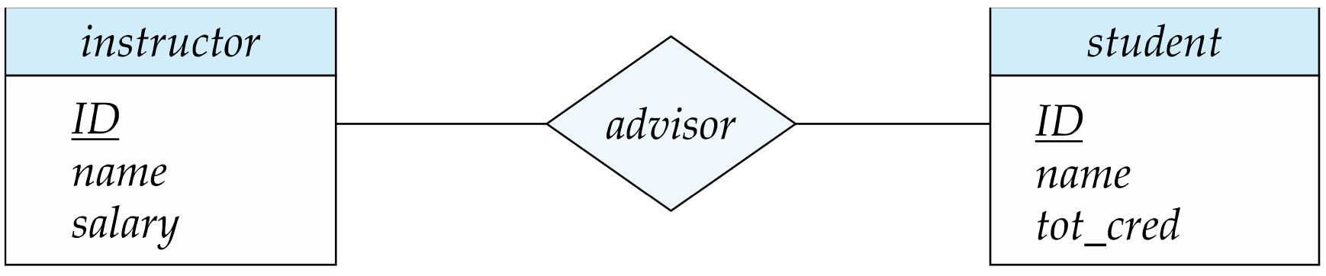
Many-to-Many Relationship
An instructor is associated with several (possibly 0) students via advisor
A student is associated with several (possibly 0) instructors via advisor

Slide 47
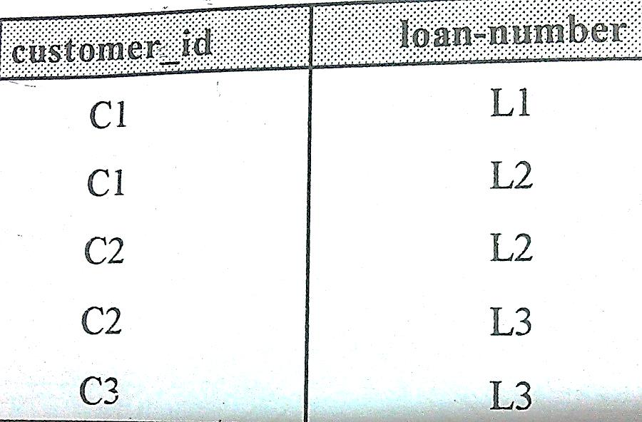
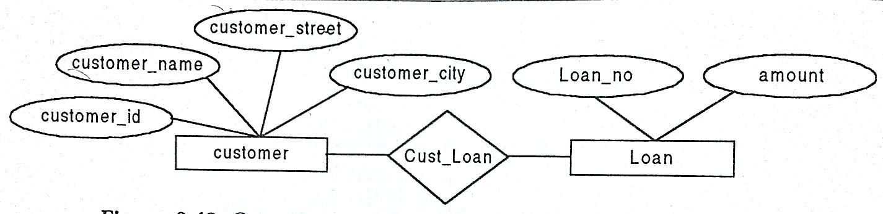

Slide 48
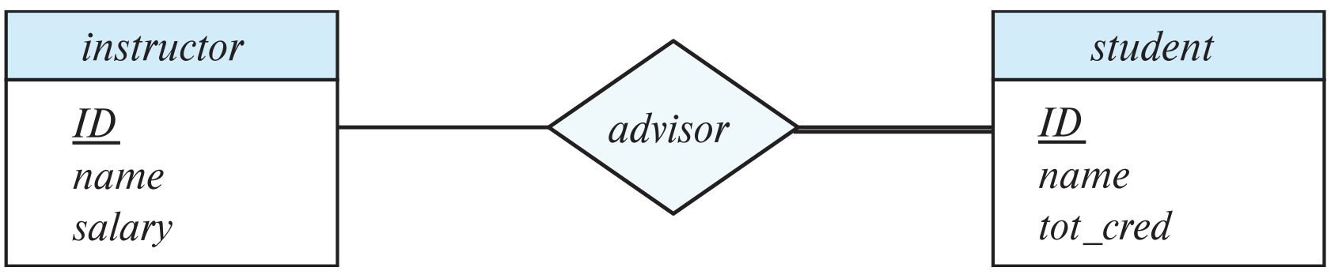
Total and Partial Participation
Total participation (indicated by double line): every entity in the entity set participates in at least one relationship in the relationship set
participation of student in advisor relation is total
every student must have an associated instructor (at least one instructor)
Partial participation: some entities may not participate in any relationship in the relationship set
Example: participation of instructor in advisor is partial (Some instructors may not have any students to advise)

Slide 49
Constraint
A restriction placed on the data.
Help to ensure data integrity
an employee's salary must have values between 6,000 and 350,000

Slide 50
Examples:
A customer may generate many invoices.
A training session cannot be scheduled for fewer than 10 employees or for more than 30 employees.

Slide 51
Notation for Expressing More Complex Constraints
A line may have an associated minimum and maximum cardinality, shown in the form l..h, where l is the minimum and h the maximum cardinality
A minimum value of 1 indicates total participation.
A maximum value of 1 indicates that the entity participates in at most one relationship
A maximum value of * indicates no limit.
Example
Instructor can advise 0 or more students. A student must have 1 advisor; cannot have multiple advisors

Slide 52
Cardinality Constraints on Ternary Relationship
We allow at most one arrow out of a ternary (or greater degree) relationship to indicate a cardinality constraint
For example, an arrow from proj_guide to instructor indicates each student has at most one guide for a project
Why Limit to One Arrow?
When more than one arrow is used, it introduces complexity in interpretation because it could mean:
1. Each entity from one set is associated with a unique combination of entities from the other two sets, or
2. Unique associations exist for pairs formed by the entities, requiring a more nuanced understanding of the relationship.
To avoid confusion we outlaw more than one arrow => for easier communication and understanding.
Notes:
This cardinality constraint implies that for any given student-project pair, there's a unique instructor associated with them. This does not restrict a student from having different instructors for different projects, nor does it restrict an instructor from guiding multiple students or projects. However, it ensures that each project a student is involved in has a distinct guiding instructor.

Slide 53
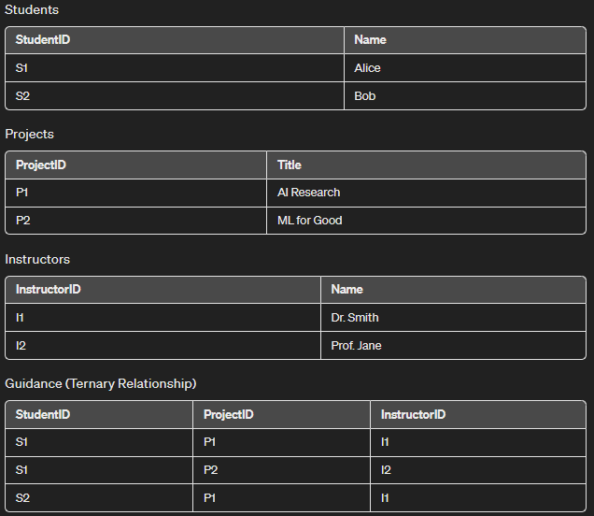
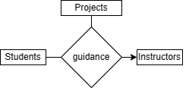
Example Data
This cardinality constraint implies that for any given student-project pair, there's a unique instructor associated with them.
Notes:
(Draw using DrwIO)
Alice (S1) is guided by Dr. Smith (I1) on AI Research (P1) and by Prof. Jane (I2) on ML for Good (P2).
Bob (S2) is also guided by Dr. Smith (I1) on AI Research (P1).

Slide 54
Primary Key
Primary keys provide a way to specify how entities and relations are distinguished.
We will consider:
Entity sets
Relationship sets.
Weak entity sets

Slide 55
Primary key for Entity Sets
By definition, individual entities are distinct.
From database perspective, the differences among them must be expressed in terms of their attributes.
The values of the attribute values of an entity must be such that they can uniquely identify the entity.
No two entities in an entity set are allowed to have exactly the same value for all attributes.
A key for an entity is a set of attributes that suffice to distinguish entities from each other

Slide 56
Primary Key for Relationship Sets
To distinguish among the various relationships of a relationship set we use the individual primary keys of the entities in the relationship set.
Let R be a relationship set involving entity sets E1, E2, .. En
The primary key for R is consists of the union of the primary keys of entity sets E1, E2, ..En
If the relationship set R has attributes a1, a2, .., am associated with it, then the primary key of R also includes the attributes a1, a2, .., am
Example: relationship set “advisor”.
The primary key consists of instructor.ID and student.ID
The choice of the primary key for a relationship set depends on the mapping cardinality of the relationship set.

Slide 57
Choice of Primary key for Binary Relationship
Many-to-Many relationships.
The preceding union of the primary keys is a minimal superkey and is chosen as the primary key.
Example: Consider a Books table and an Authors table. A book can have multiple authors, and an author can write multiple books.
One-to-Many relationships.
The primary key of the “Many” side is a minimal superkey and is used as the primary key.
Example: Consider a Departments table and an Employees table where one department can have many employees, but each employee belongs to only one department.
Many-to-one relationships.
The primary key of the “Many” side is a minimal superkey and is used as the primary key.
One-to-one relationships.
The primary key of either one of the participating entity sets forms a minimal superkey, and either one can be chosen as the primary key.
Example: Consider a Users table and a UserDetails table where each user has only one set of details, and each set of details is associated with only one user.

Slide 58
Key of Database
› Example course management database with schema
Sid | Name | GPA
20201 | Amy | 3.1
20202 | Tom | 3.5
20203 | Ben | 3.5
20204 | Tom | 3.2
Sid | CoureID | Grade
20201 | 101 | A
20201 | 102 | A
20202 | 101 | B
20203 | 103 | B
20204 | 101 | A
CourseID | Coursename | Credits
101 | COMP1 | 6
102 | COMP2 | 6
103 | COMP3 | 6
203 | COMP3 | 12
tuple
- Students(Sid,Name, GPA)
- Courses(CourseID,Coursename,Credits)
Attributes
- Enrolled(Sid,CourseID,Grade)
Entity
Entity
Attributes
Entity
Attributes
Primary Key: The minimal set of attributes that can be used to uniquely identify each tuple in a relation.
Secondary Key: Attributes that can not be used to uniquely identify each tuple in a relation.
2

Slide 59
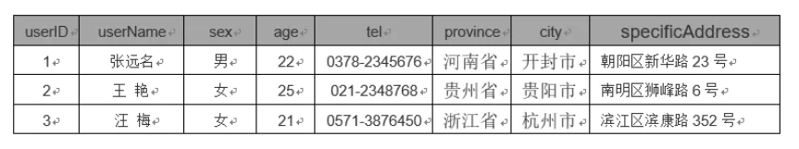
What is the primary key in this table?

Slide 60
What is the primary key in this table?
Sid | Name | Contact-details | Department | Director | CourseID | Grade
20201 | Amy | 84038231, Amy@163.com | Software | Li | 101 | A
20201 | Amy | 84038231, Amy@163.com | Software | Li | 102 | B
20201 | Amy | 84038231, Amy@163.com | Software | Li | 103 | B
20202 | Tom | 82839173, Tom@163.com | Software | Li | 101 | A
20202 | Tom | 82839173, Tom@163.com | Software | Li | 102 | B
20202 | Tom | 82839173, Tom@163.com | Software | Li | 104 | A
20203 | Ben | 82392312, Ben@163.com | E-commerce | Chen | 101 | A
20203 | Ben | 82392312, Ben@163.com | E-commerce | Chen | 205 | A
Notes:
After we have learn the structure of relation table, can we easily build an efficient database?
For example, we bulid a table based on what we have learned before. This table contains all the attributes like dean which represents department director, and the primary key of this relation is the set of sid and course id. However, What are the problems with this table? Here we can see that it contains redundant information and it can't select the detailed email of a specific student.

Slide 61
Weak Entity Sets
Consider a section entity, which is uniquely identified by a course_id, semester, year, and sec_id.
Clearly, section entities are related to course entities. Suppose we create a relationship set sec_course between entity sets section and course.
Note that the information in sec_course is redundant, since section already has an attribute course_id, which identifies the course with which the section is related.
One option to deal with this redundancy is to get rid of the relationship sec_course; however, by doing so the relationship between section and course becomes implicit in an attribute, which is not desirable.

Slide 62
Weak Entity Sets (Cont.)
An alternative way to deal with this redundancy is to not store the attribute course_id in the section entity and to only store the remaining attributes section_id, year, and semester.
However, the entity set section then does not have enough attributes to identify a particular section entity uniquely
To deal with this problem, we treat the relationship sec_course as a special relationship that provides extra information, in this case, the course_id, required to identify section entities uniquely.
A weak entity set is one whose existence is dependent on another entity, called its identifying entity
Instead of associating a primary key with a weak entity, we use the identifying entity, along with extra attributes called discriminator to uniquely identify a weak entity.

Slide 63
Weak Entity Sets (Cont.)
An entity set that is not a weak entity set is termed a strong entity set.
Every weak entity must be associated with an identifying entity; that is, the weak entity set is said to be existence dependent on the identifying entity set.
The identifying entity set is said to own the weak entity set that it identifies.
The relationship associating the weak entity set with the identifying entity set is called the identifying relationship.
Note that the relational schema we eventually create from the entity set section does have the attribute course_id, for reasons that will become clear later, even though we have dropped the attribute course_id from the entity set section.

Slide 64
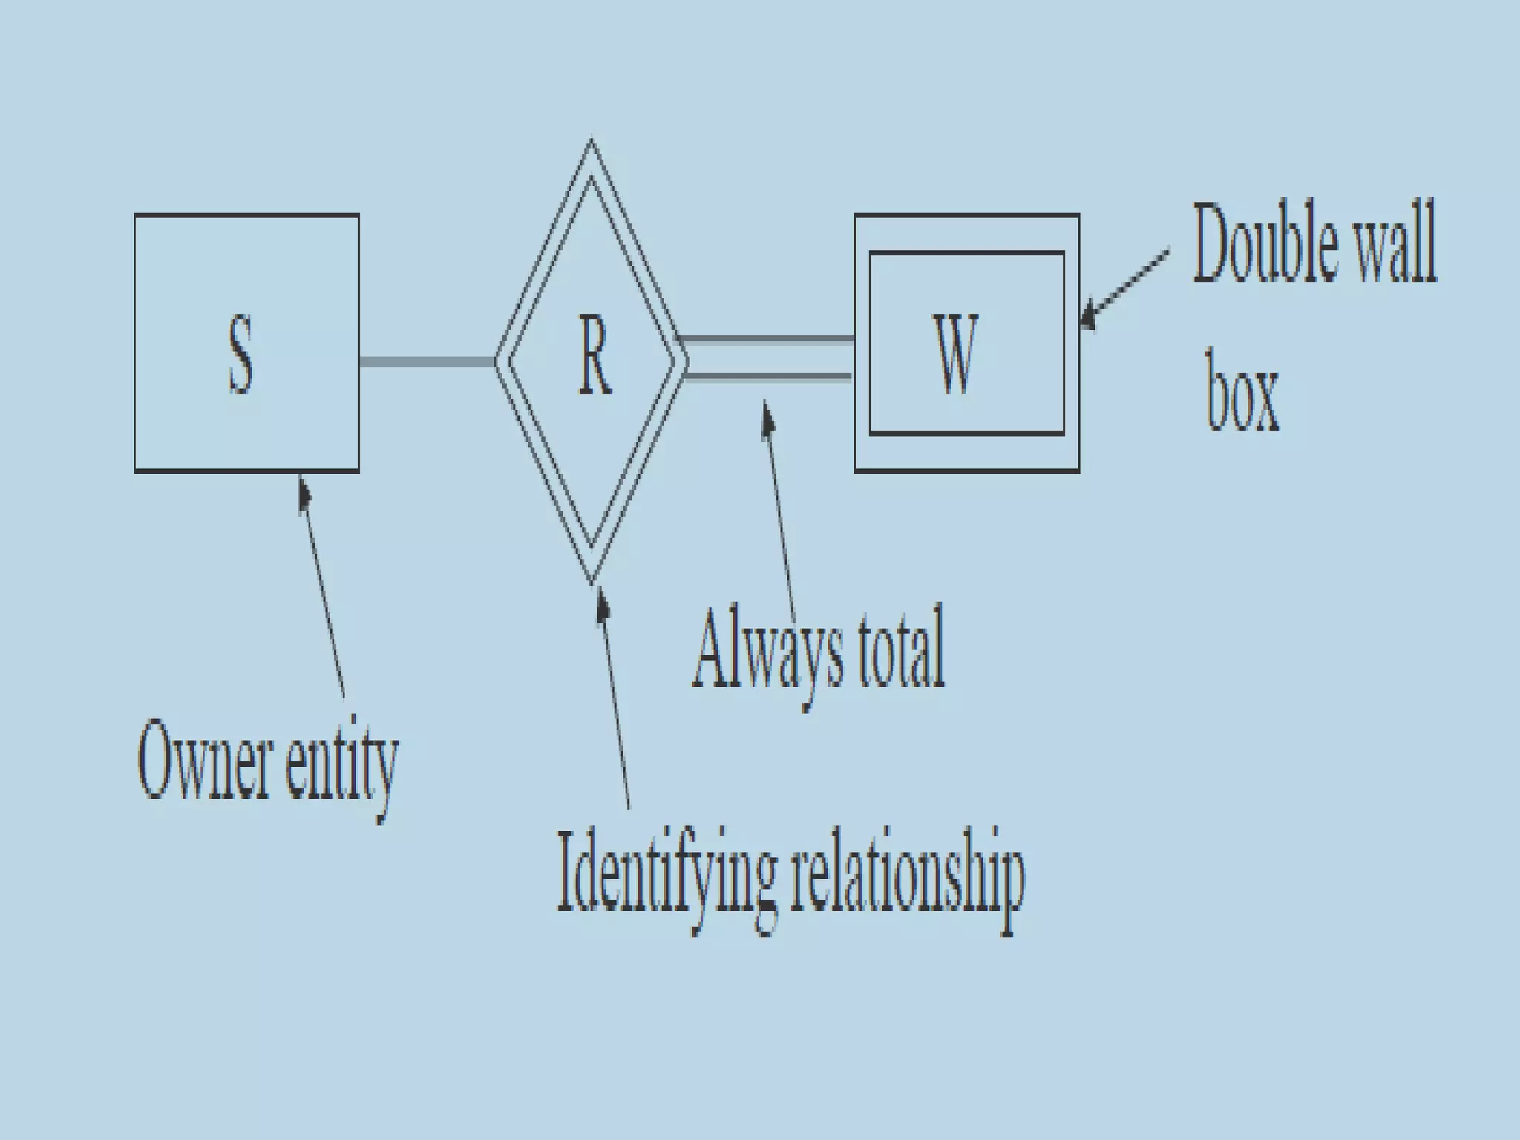

Slide 65
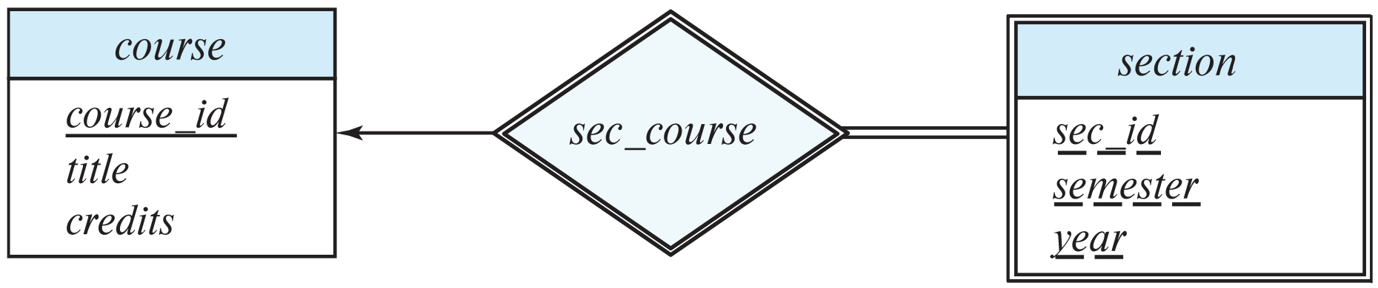
Expressing Weak Entity Sets
In E-R diagrams, a weak entity set is depicted via a double rectangle.
We underline the discriminator of a weak entity set with a dashed line.
The relationship set connecting the weak entity set to the identifying strong entity set is depicted by a double diamond.
Primary key for section – (course_id, sec_id, semester, year)=> Discriminator

Slide 66
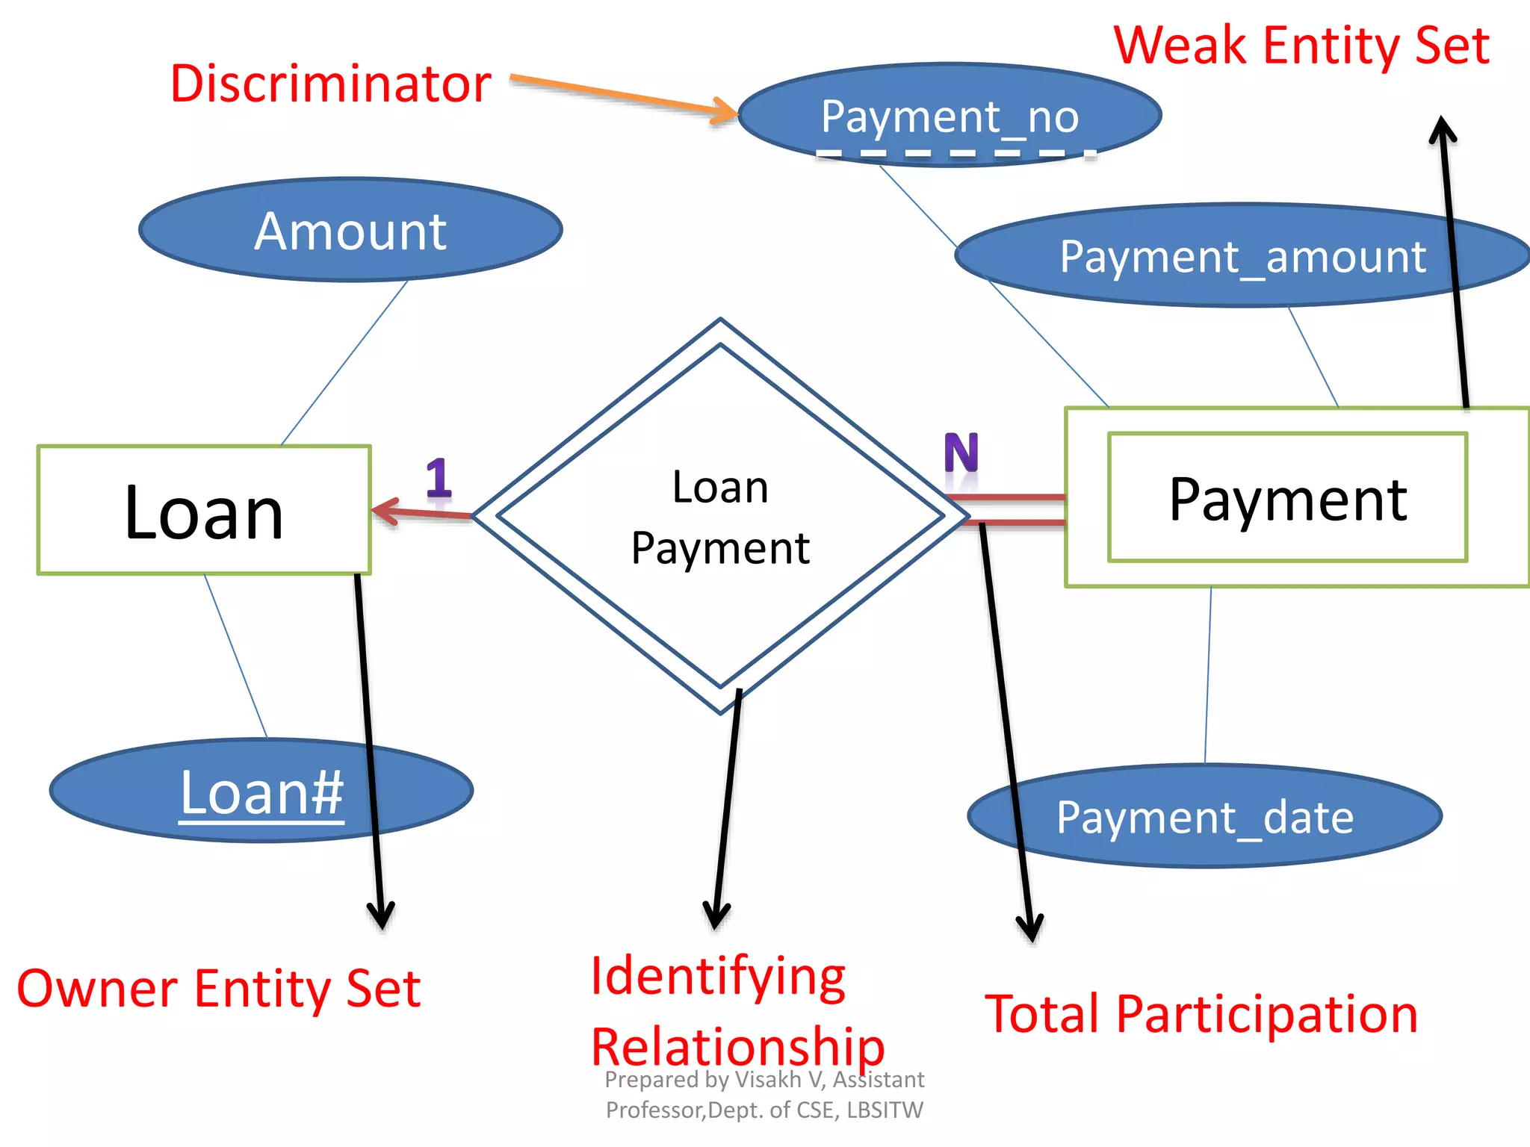

Partial key: Uniquely identifies a section among the set of sections of a particular course
Note: The identifying relationship set should not have descriptive attributess (addditional attributes)

Slide 67
Class Activity
github

Slide 68
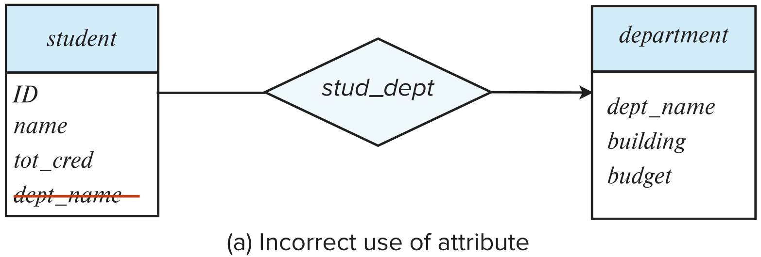
Redundant Attributes
Suppose we have entity sets:
student, with attributes: ID, name, tot_cred, dept_name
department, with attributes: dept_name, building, budget
We model the fact that each student has an associated department using a relationship set stud_dept
The attribute dept_name in student below replicates information present in the relationship and is therefore redundant
and needs to be removed.
BUT: when converting back to tables, in some cases the attribute gets reintroduced, as we will see later.

Slide 69
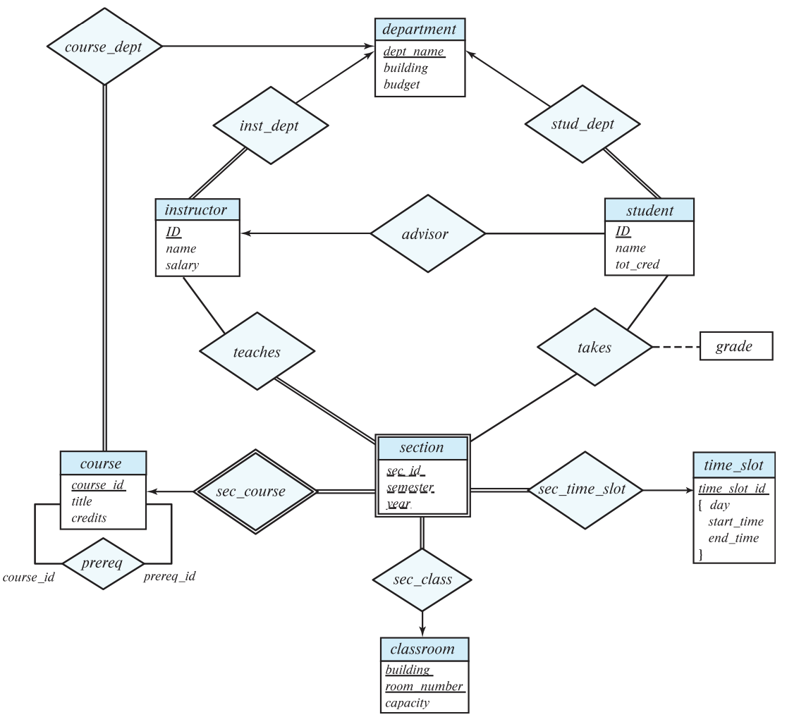
E-R Diagram for a University Enterprise

Slide 70
Reduction to Relation Schemas

Slide 71
Reduction to Relation Schemas
Entity sets and relationship sets can be expressed uniformly as relation schemas that represent the contents of the database.
A database which conforms to an E-R diagram can be represented by a collection of schemas.
For each entity set and relationship set there is a unique schema that is assigned the name of the corresponding entity set or relationship set.
Each schema has a number of columns (generally corresponding to attributes), which have unique names.

Slide 72
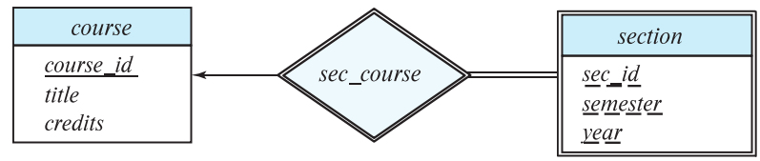
Representing Entity Sets
A strong entity set reduces to a schema with the same attributes
student(ID, name, tot_cred)
A weak entity set becomes a table that includes a column for the primary key of the identifying strong entity set
section ( course_id, sec_id, sem, year )
Example
Notes:
A weak entity set has a partial key, which is an attribute that can uniquely identify weak entities that are related to the same strong entity.
course_id: Acts as a foreign key linking to the primary key of the course (the strong entity) this section belongs to.
sec_id: A partial key that uniquely identifies sections within the context of a single course.
sem and year: Additional attributes that, together with course_id and sec_id, help to uniquely identify a section.

Slide 73
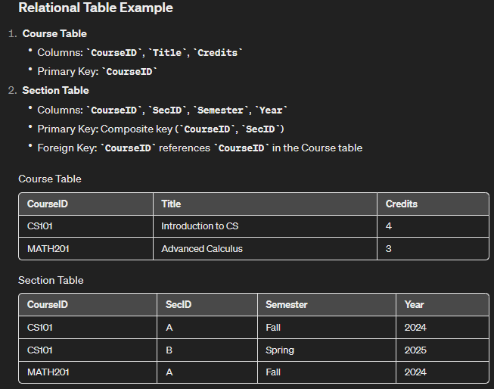

Slide 74
Representation of Entity Sets with Composite Attributes
Composite attributes are flattened out by creating a separate attribute for each component attribute
Example: given entity set instructor with composite attribute name with component attributes first_name and last_name the schema corresponding to the entity set has two attributes name_first_name and name_last_name
Prefix omitted if there is no ambiguity (name_first_name could be first_name)
Ignoring multivalued attributes, extended instructor schema is
instructor(ID, first_name, middle_initial, last_name, street_number, street_name, apt_number, city, state, zip_code, date_of_birth)

Slide 75
Representation of Entity Sets with Multivalued Attributes
A multivalued attribute M of an entity E is represented by a separate schema EM
Schema EM has attributes corresponding to the primary key of E and an attribute corresponding to multivalued attribute M
Example: Multivalued attribute phone_number of instructor is represented by a schema: inst_phone= ( ID, phone_number)
Each value of the multivalued attribute maps to a separate tuple of the relation on schema EM
For example, an instructor entity with primary key 22222 and phone numbers 456-7890 and 123-4567 maps to two tuples: (22222, 456-7890) and (22222, 123-4567)

Slide 76
Representing Relationship Sets
A many-to-many relationship set is represented as a schema with attributes for the primary keys of the two participating entity sets, and any descriptive attributes of the relationship set.
Example: schema for relationship set advisor
advisor = (s_id, i_id)

Slide 77
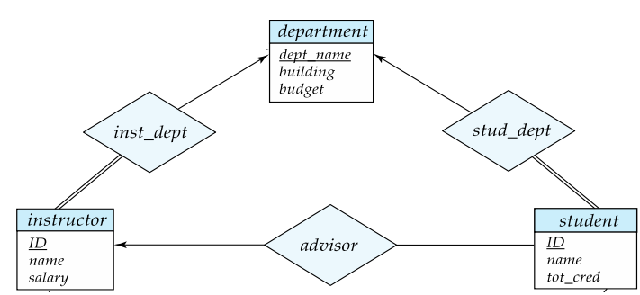
Redundancy of Schemas
Many-to-one and one-to-many relationships, can often be addressed or simplified by adjusting the database design.
Specifically, when a relationship is total on the "many" side, it implies that every instance in the "many" side must be associated with an instance on the "one" side.
In such cases, you can streamline the database schema by adding an attribute to the "many" side to directly reference the "one" side, instead of creating a separate relationship table.
Example: Instead of creating a schema for relationship set inst_dept, add an attribute dept_name to the schema arising from entity set instructor.
Example
Instructors table (modified)
InstructorID (PK)
Name
DepartmentID (FK )
Salary
Departments table
DepartmentID (PK)
DeptName
Building
Budget
Advantages of Reducing Redundancy
Simplicity: The database schema becomes easier to understand and manage.
Performance: Queries can be faster due to fewer join operations.
Integrity: Directly linking entities can help maintain referential integrity more straightforwardly.

Slide 78
Redundancy of Schemas (Cont.)
For one-to-one relationship sets, either side can be chosen to act as the “many” side
That is, an extra attribute can be added to either of the tables corresponding to the two entity sets
If participation is partial on the “many” side, replacing a schema by an extra attribute in the schema corresponding to the “many” side could result in null values
Scenario 1: Adding an Attribute to the DriverLicense Table
In this scenario, we consider each person may or may not have a driver's license (partial participation from the Person side), but every driver's license is associated with exactly one person.
Person Table:
PersonID (PK)
Name
DateOfBirth
DriverLicense Table:
LicenseID (PK)
IssueDate
ExpirationDate
PersonID (PK)
Scenario 2: Adding an Attribute to the Person Table
Alternatively, if we somehow want to reverse the relationship direction considering different constraints or requirements:
Person Table:
PersonID (PK)
Name
DateOfBirth
LicenseID (FK)
DriverLicense Table:
LicenseID (PK)
IssueDate
ExpirationDate

Slide 79
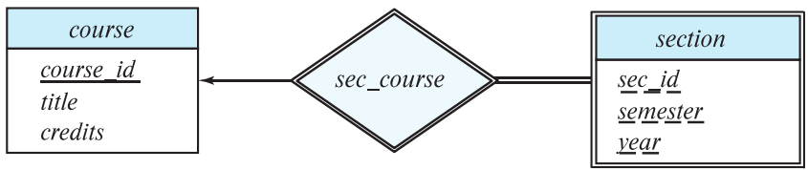
Redundancy of Schemas (Cont.)
The schema corresponding to a relationship set linking a weak entity set to its identifying strong entity set is redundant.
Example: The section schema already contains the attributes that would appear in the sec_course schema
sec_course Schema:
CourseID
SectionNumber
Possibly other attributes indicating the relationship details
However, this sec_course schema would be redundant because the Section schema already contains the CourseID attribute to link each section to its course.
The Section schema essentially embeds the relationship by including CourseID in its composite primary key, making a separate relationship schema unnecessary.

Slide 80
Extended E-R Features
Notes:
The Enhanced ER Model

Slide 81
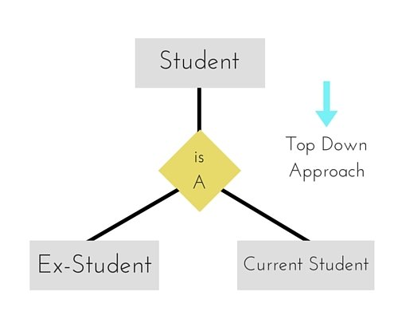
Specialization
Top-down design process; we designate sub-groupings within an entity set that are distinctive from other entities in the set.
These sub-groupings become lower-level entity sets that have attributes or participate in relationships that do not apply to the higher-level entity set.
Depicted by a triangle component labeled ISA -is a (e.g., instructor “is a” person).
Attribute inheritance – a lower-level entity set inherits all the attributes and relationship participation of the higher-level entity set to which it is linked.

Slide 82
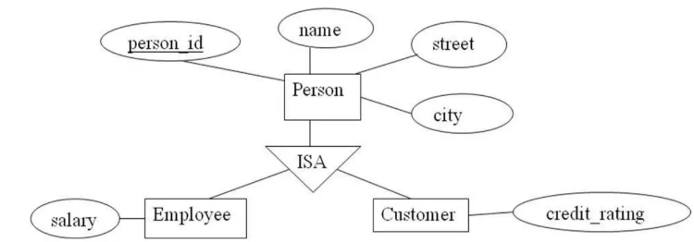
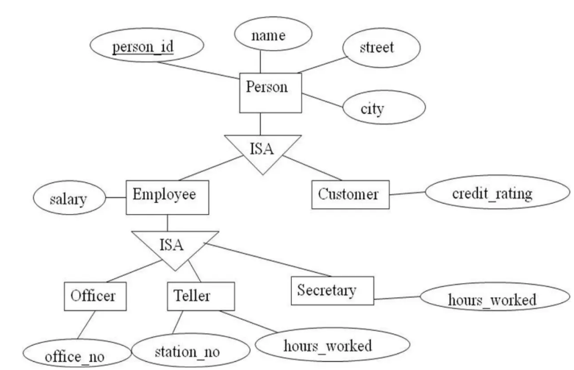
We can apply specialization repeatedly to refine a design scheme

Slide 83
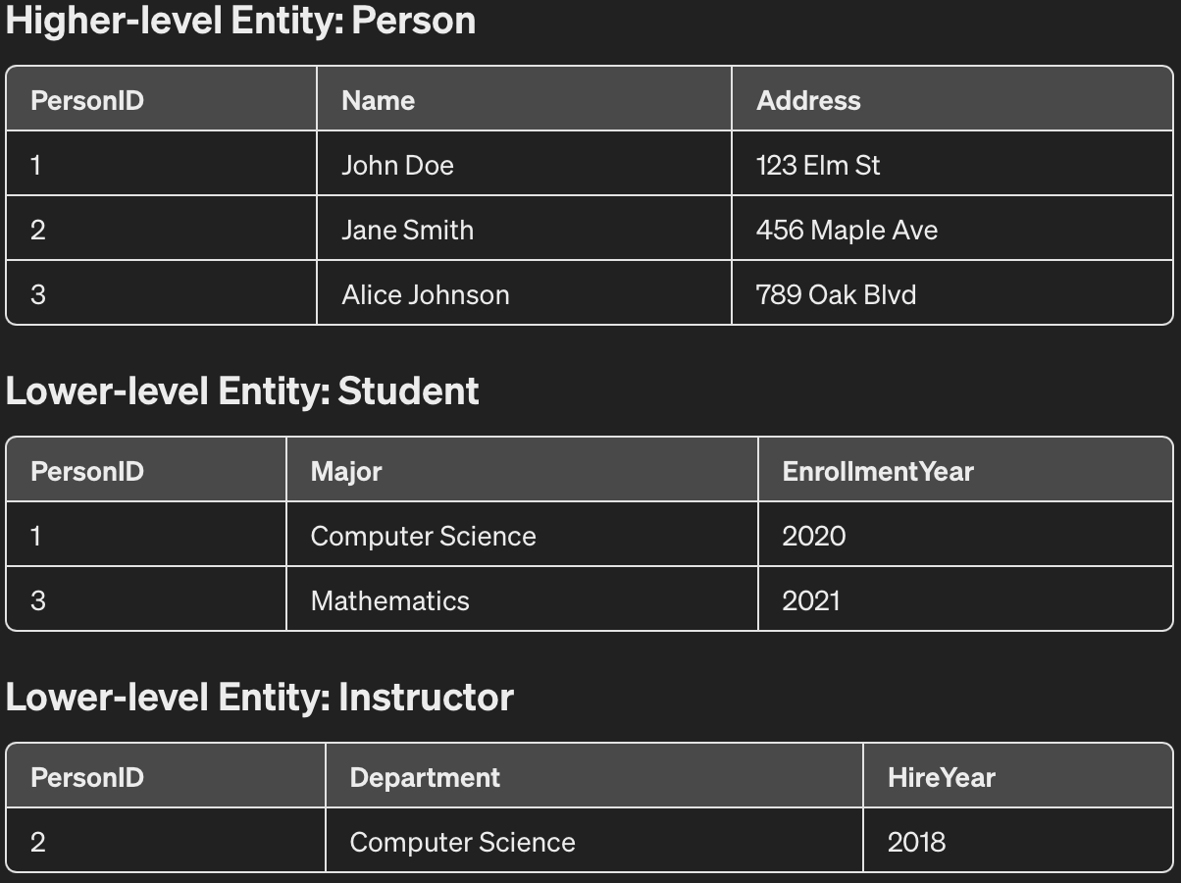
Explain how you would identify all students majoring in Computer Science including their names, addresses, and enrollment years,

Slide 84
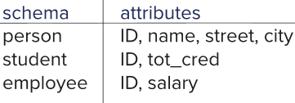
Representing Specialization via Schemas
Method 1:
Form a schema for the higher-level entity
Form a schema for each lower-level entity set, include primary key of higher-level entity set and local attributes
Drawback: getting information about, an employee requires accessing two relations, the one corresponding to the low-level schema and the one corresponding to the high-level schema
Notes:
This requirement can lead to inefficiencies:
Increased complexity in query formulation: Queries need to join the higher-level and lower-level schemas based on the primary key to assemble all relevant information about an entity.
Potential performance impact: Accessing two relations and performing a join operation can lead to increased processing time, especially if the databases are large or if the operations are frequent.

Slide 85
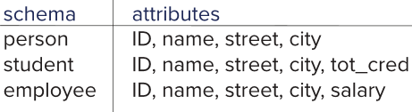
Representing Specialization as Schemas (Cont.)
Method 2:
Form a schema for each entity set with all local and inherited attributes
Drawback: name, street and city may be stored redundantly for people who are both students and employees

Slide 86
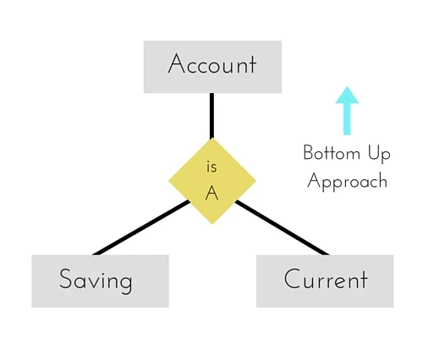
Generalization
A bottom-up design process – combine a number of entity sets that share the same features into a higher-level entity set.
Specialization and generalization are simple inversions of each other; they are represented in an E-R diagram in the same way.
The terms specialization and generalization are used interchangeably.

Slide 87
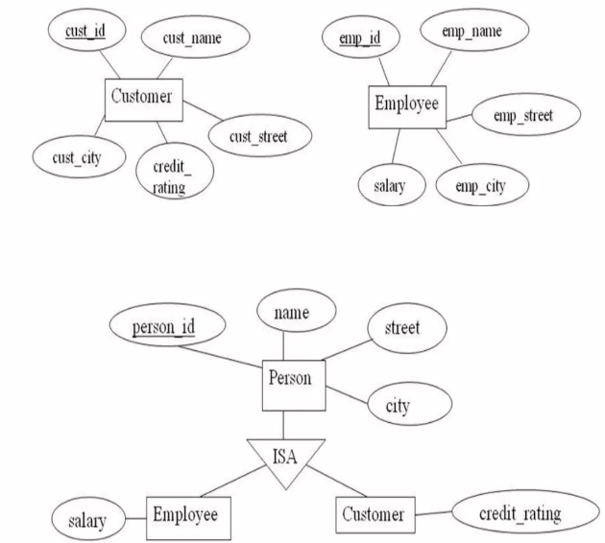

Slide 88
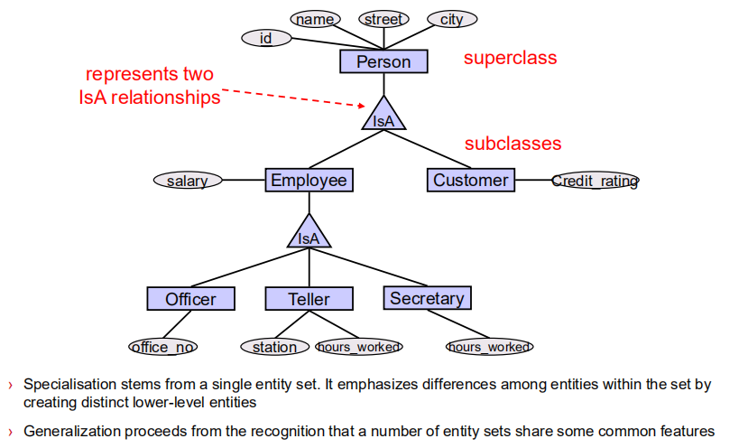

Slide 89
Constraints on Specialization / Generalization
A second type of constarint relates to whether or not entities may belong to more than one lower-level entity set within a single generalization.
The lower-level entity sets may be one of the following:
Disjoint: A disjoint-ness constraints requires that an entity belong to no more than one lower-level entity set.
Overlapping: In overlapping generalizations, the same entity may belong to more than one lower-level entity set within a single generalization.
Lower-level entity overlap is the defaullt case; a disjoint-ness constraint must be placed explicitlly on a generalization (or specialization).
We can note a disjointedness constraints in an E-R diagram by adding the word disjoint next to the traingle symbol.

Slide 90
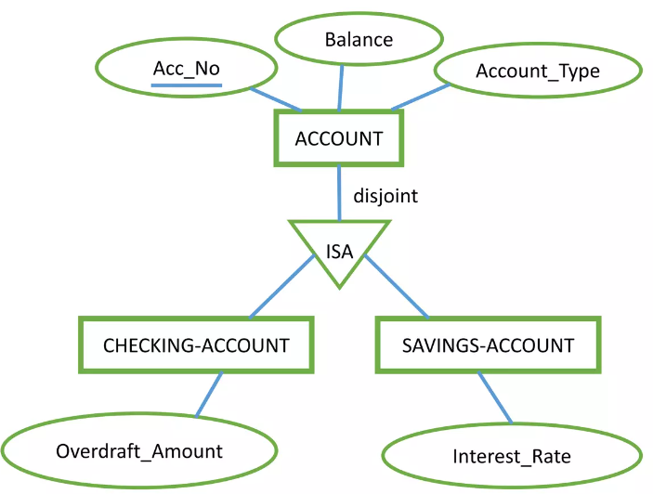
Disjoint Constraint

Slide 91
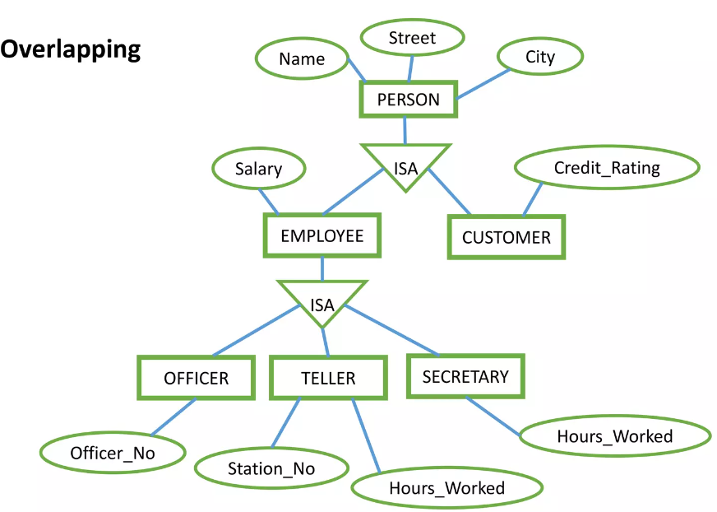
Overlapping

Slide 92
Constarints on Specialization / Generalization
A final constraint, the completeness constraint on a generalization or specialization, specifies whether or not an entity in the higher-level entity set must belong to at least one off the lower-level entity sets within the generalization/specialization. This constraints may be one of the following:
Total generalization or specialization: Each higher-level entity must belong to a lower-level entity set.
Partial generalization or specialization: Some higher-level entities may not belong to any lower-level entity set.
Partial generalization is the default.
We can specify total generalization in an E-R diagram by using a double line to connect the box representing the higher-level entity set to the triangle symbol.

Slide 93
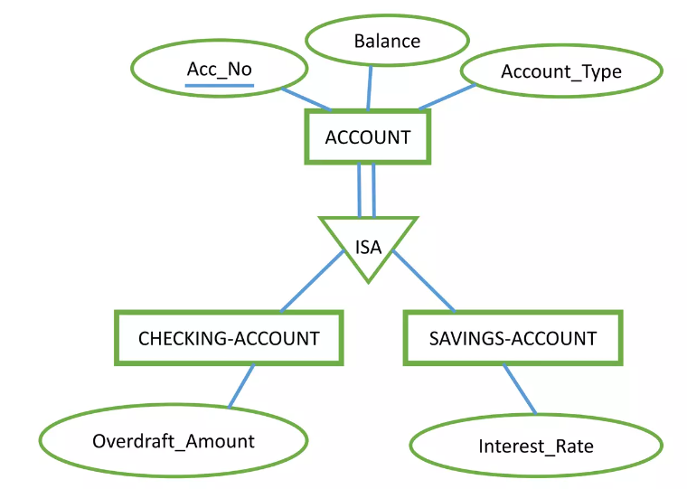
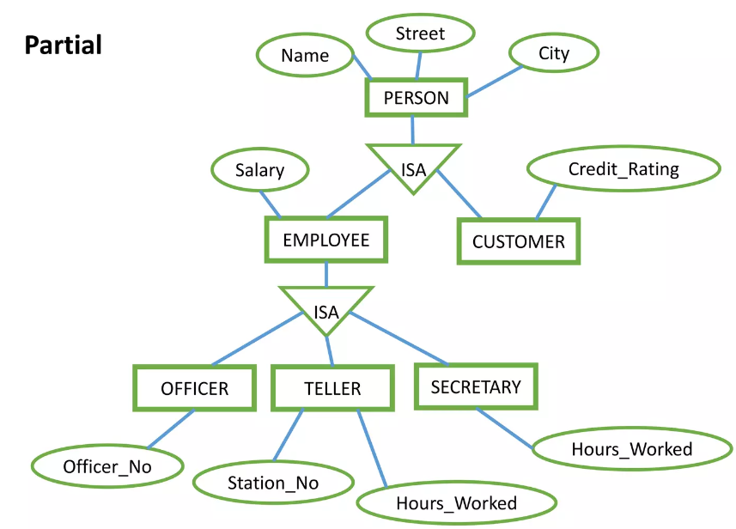
Total & Partial Specialization/ Generalization
Total

Slide 94
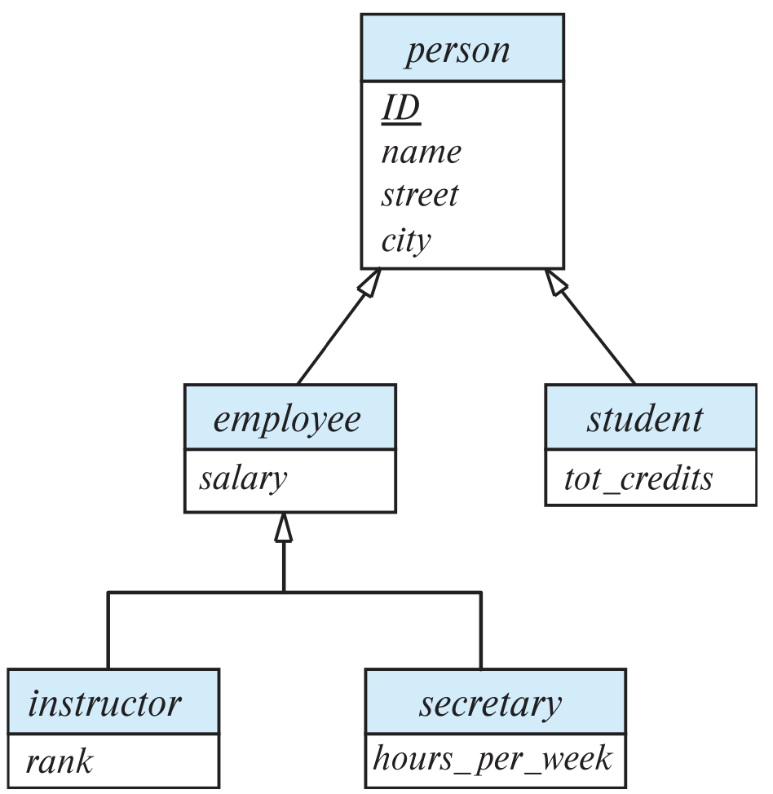
Specialization Example
Overlapping – employee and student
Disjoint – instructor and secretary
Total and partial

Slide 95
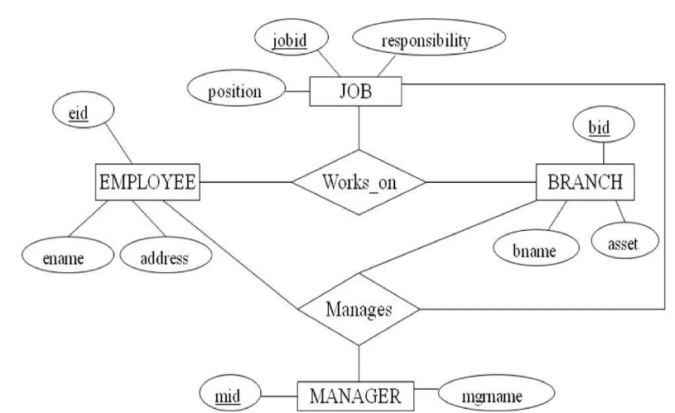
Aggregation
One limitation of the ER model is that it can not express relationship among relationships
Aggregration is a process when relation between two entities is treated as a single entity.

Slide 96
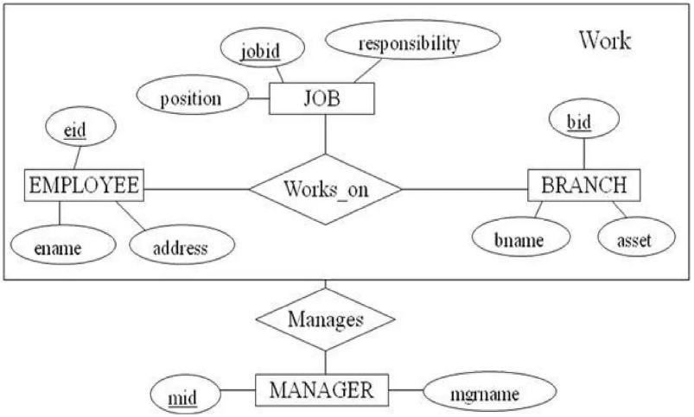
Aggregation (Cont.)
Eliminate this redundancy via aggregation
Treat relationship as an abstract entity
Allows relationships between relationships
Abstraction of relationship into new entity

Slide 97
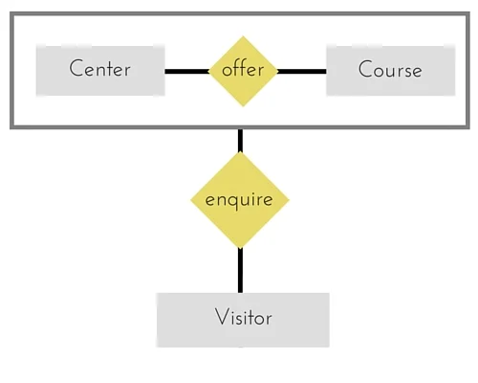
Aggregation (Cont.)
In the diagram, the relationship between Center and Course together, is acting as an Entity, which is in relationship with another entity Visitor. Now in real world, if a Visitor or a Student visits a Coaching Center, he/she will never enquire about the center only or just about the course, rather he/she will ask enquire about both.
Notes:
In the diagram above, the relationship between Center and Course together, is acting as an Entity, which is in relationship with another entity Visitor. Now in real world, if a Visitor or a Student visits a Coaching Center, he/she will never enquire about the center only or just about the course, rather he/she will ask enquire about both.

Slide 98

Reduction to Relational Schemas
To represent aggregation, create a schema containing
Primary key of the aggregated relationship,
The primary key of the associated entity set
Any descriptive attributes
In our example:
The schema eval_for is:
eval_for (s_ID, project_id, i_ID, evaluation_id)
The schema proj_guide is redundant.

Slide 99

Draw the ER diagram for a banking enterprise

Slide 100
Design Issues

Slide 101
Design Issues
There are number of different ways to define set of entities and relationship among them. We examine basic issues in the design of an E-R model. These are:
Use of entity sets vs. attributes
Use of entity sets vs. relationship sets
Binary versus n-ary relationship sets
Placement of relationship attributes

Slide 102

Design Issues: Use of entity sets vs. attributes
Choice mainly depends on the structure of the enterprise being modeled, and on the semantics associated with the attribute in question

Slide 103

Design Issues: Use of entity sets vs. relationship sets
Each loan is represented by a relationship between a customer and a branch, if every loan is associated with exactly one customer and is associated with exactly one branch
If several customers hold a joint loan then, loan should be considered as an entity

Slide 104

Cont...
The guideline in determining whether to use an entity set or a relationship set is to designate a relationship set to describe an action that occurs between entities
Placement of relationship attributes
For example, attribute date as attribute of advisor or as attribute of student

Slide 105


Placement of Relationship Attributes

Slide 106
Class Activity (Think and Write)
For the following E-R diagram specify the attribute placement of relationship
One-to-one
One-to-many
Many-to-Many
github

Slide 107

Binary Vs. Non-Binary Relationships
Although it is possible to replace any non-binary (n-ary, for n > 2) relationship set by a number of distinct binary relationship sets, a n-ary relationship set shows more clearly that several entities participate in a single relationship.
Some relationships that appear to be non-binary may be better represented using binary relationships
For example, a ternary relationship parents, relating a child to his/her father and mother, is best replaced by two binary relationships, father and mother
Using two binary relationships allows partial information (e.g., only mother being known

Slide 108

Binary Vs n-array Relationship Sets
There is one advantage of using binary relationship, with this it is possible to store partial information but in ternary relationship it is not possible to represent it.
But there are some relationships that are naturally non-binary.

Slide 109

Converting Non-Binary Relationships to Binary Form
In general, any non-binary relationship can be represented using binary relationships by creating an artificial entity set.
Replace R between entity sets A, B and C by an entity set E, and three relationship sets:
1. R_{A}, relating E and A 2. R_{B}, relating E and B 3. R_{C}, relating E and C
Create an identifying attribute for E and add any attributes of R to E
For each relationship (a_{i} , b_{i} , c_{i}) in R, create
1. a new entity e_{i} in the entity set E 2. add (e_{i} , a_{i} ) to R_{A}
3. add (e_{i} , b_{i} ) to R_{B} 4. add (e_{i} , c_{i} ) to R_{C}

Slide 110
Converting Non-Binary Relationships (Cont.)
Also need to translate constraints
Translating all constraints may not be possible
There may be instances in the translated schema that cannot correspond to any instance of R
We can avoid creating an identifying attribute by making E a weak entity set (described shortly) identified by the three relationship sets

Slide 111
Class Activity
Converting Non-Binary Relationships to Binary
Github

Slide 112
E-R Design Decisions
The use of an attribute or entity set to represent an object.
Whether a real-world concept is best expressed by an entity set or a relationship set.
The use of a ternary relationship versus a pair of binary relationships.
The use of a strong or weak entity set.
The use of specialization/generalization – contributes to modularity in the design.
The use of aggregation – can treat the aggregate entity set as a single unit without concern for the details of its internal structure.

